Slide 1

TRUSTED SCHOOLS PROUDLY PRESENT…

Slide 2

Competition 2 Silent Movie

Slide 3
TrustEd Silent Movie Competition!
In December, our Trust will be holding its first ever SILENT MOVIE competition!
Winning teams from all Key Stages will be selected to attend the final performance show on 5th December, hosted by Mary Webb School!
There will be prizes for the Champions!

Slide 4
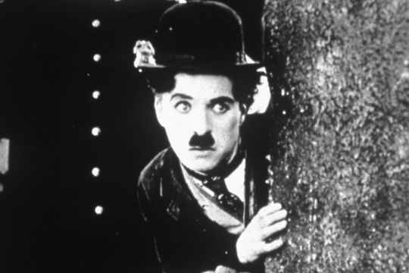
Silent Movies
A silent film is a movie from the late 19th and early 20th centuries without recorded dialogue (speaking).
While the film itself had no speaking, these movies were typically accompanied by live music from a pianist, organist, or orchestra.
Silent films use intertitles to convey key plot points and dialogue, relying heavily on visual storytelling, acting, and gestures

Slide 5
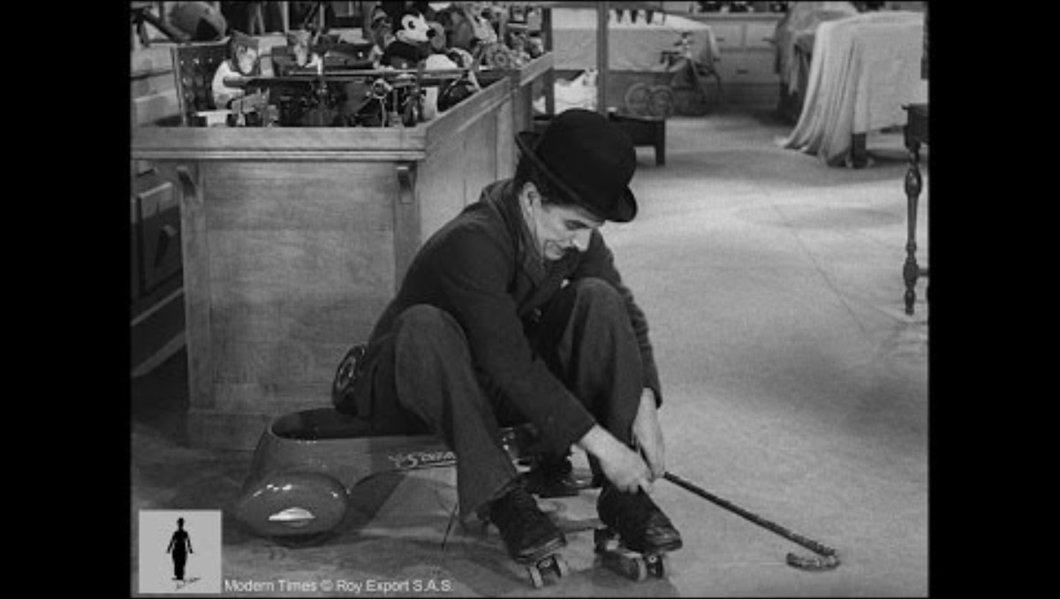

Slide 6
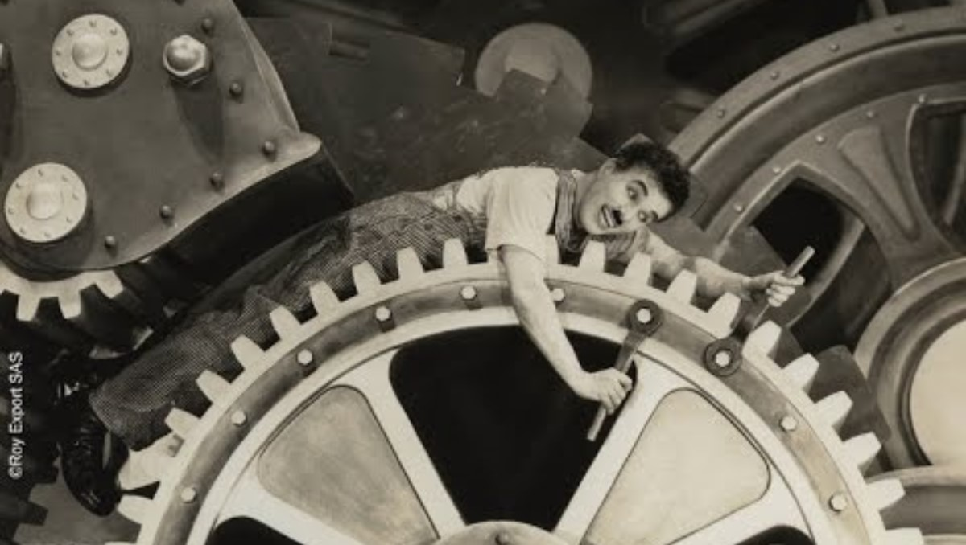

Slide 7
The Rules!

Slide 8

1
You need to be in a
group of 2-4 people

Slide 9
2
Select a theme from the
following page –
this will be your Movie title

Slide 10
The storm
The shop
The school
The pub
The friends
The enemies
The hairdresser’s
The Church

Slide 11
3
You need to plan your
movie scene as well as your
word cards (intertitles)

Slide 12
4
Your movie should last
at least 2 minutes,
but no longer than 5 minutes

Slide 13
5
The movie can be
Pre-recorded and shown on
Screen or can be performed live

Slide 14
6
The closing date for entries
to be emailed to Mrs Hanmer is
Friday 28th November

Slide 15
7
Performances will be recorded
and may be shared on the
TrustEd Schools website

Slide 16
We really look forward to seeing what you can produce!!!

Slide 17
For more information – see
XXXXXXXXX

